Slide 1
A Machine learning Framework for classification of Restaurant Inspection Report
Manish Kumar
Chang School of Continuing Studies, Ryerson University
Toronto

Slide 2
Outline
Introduction
Data Gathering
Exploratory Data Analysis
Feature Engineering
Machine Learning Framework
Discussion & Conclusion
‹#›

Slide 3
Introduction
DOHMH Inspection Results
Department of Health and Mental Hygiene conducts regular inspections in restaurants and other food serving facilities in New York
Each record in dataset in the inspection result carried out by DOHMH
Goal of our research
The goal of our capstone project would be to classify the influence of inspection record in terms of closing of the facility or keeping it open.

Slide 4
How to acquire data?
The dataset is hosted by New York city open source portal under the link:
https://data.cityofnewyork.us/Health/DOHMH-New-York-City-Restaurant-Inspection-Results/43nn-pn8j
Format of the data can be found in both : csv and json

Slide 5
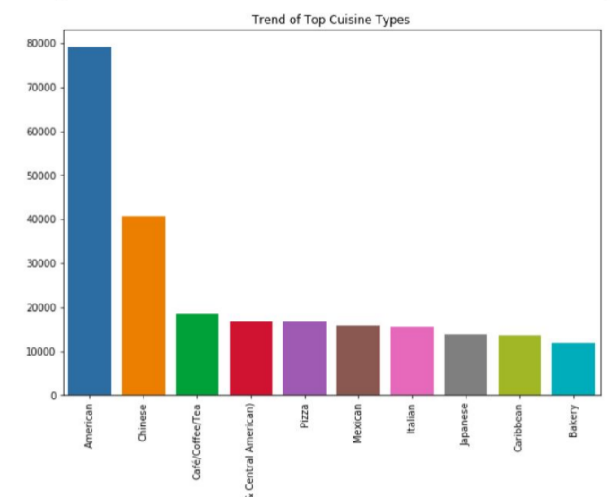
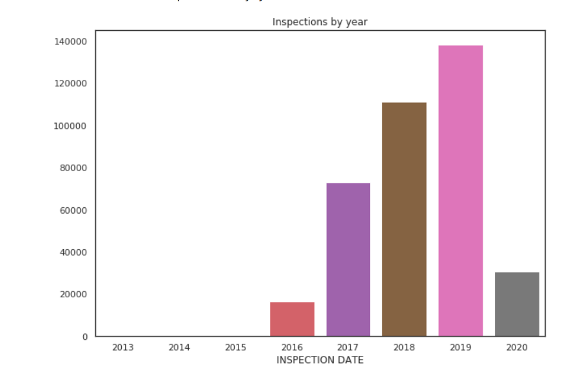
Exploratory Data Analysis (Part 1)

Slide 6
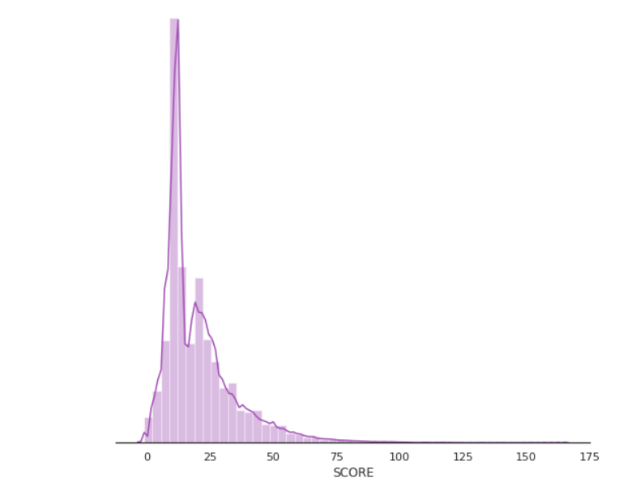
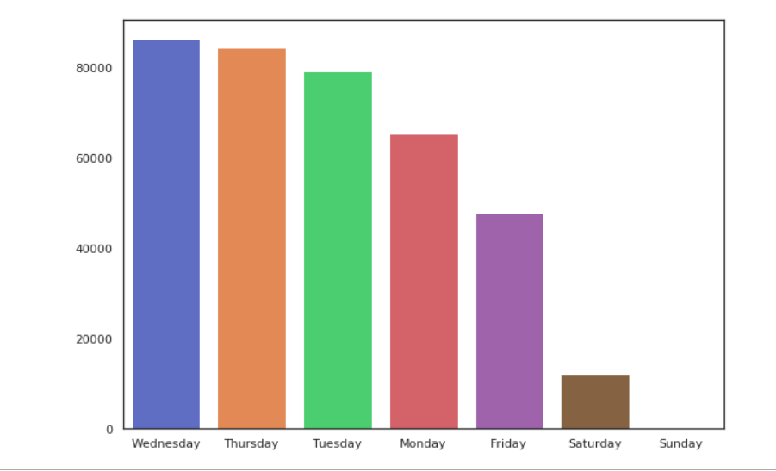
Exploratory Data Analysis-Part 2

Slide 7
Feature Engineering
Label Encoding for columns [‘CUISINE TYPE’, ‘NEW YORK BORO LOCATION’,’INSPECTION DATE’,’GRADE VALUES’,’CRITICAL VALUE’,’VIOLATION CODE’] using pd.get_dummies
NLP techniques using tf-idf and k-means to convert text into numeric
Open source library texthero
For scaling purposes, I have used both Normalization and Standardization techniques using sklearn MinMaxScaler and StandardScaler

Slide 8
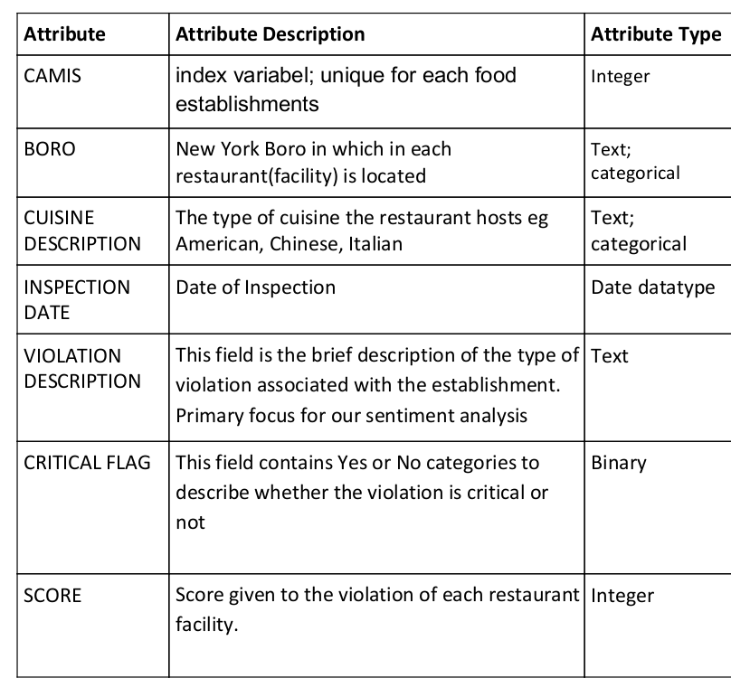
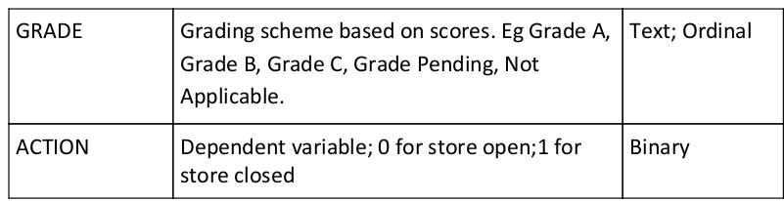
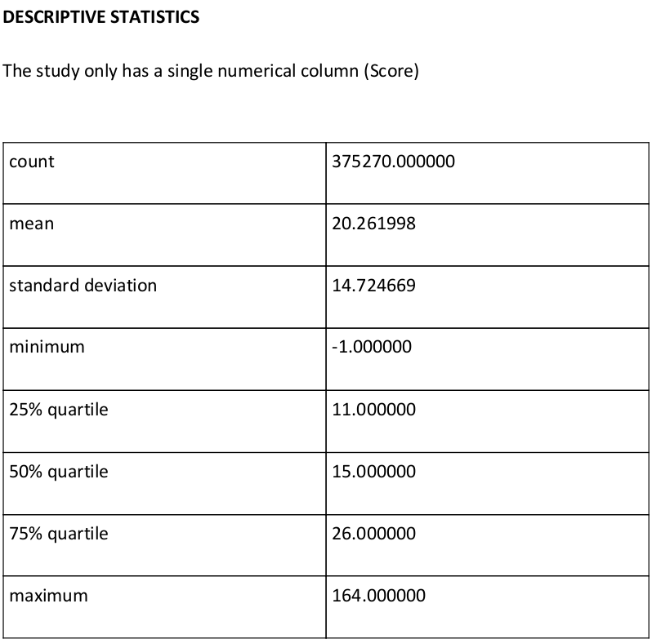
Feature Engineering -Part 2

Slide 9



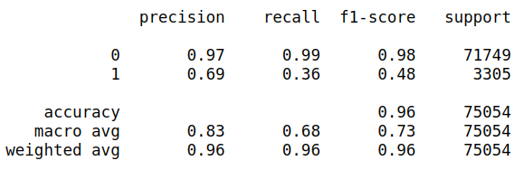
Modeling
Logistic Regression
Normal Data Normalized Data
Classification Report

Slide 10

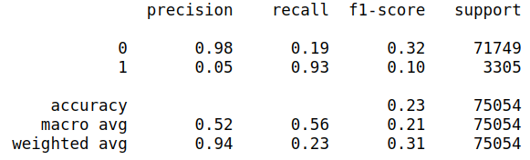
Modeling- Part 2
Naive Bayes
Accuracy of model:

Slide 11



Modeling-Part 3
Decision Tree Classifier
Normal Data Normalized Data

